Slide 1
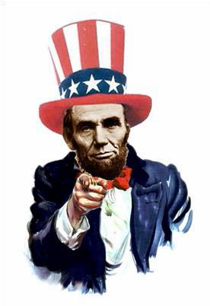
WE WANT YOU!
VOLUNTEER
at
The National Civil War Museum
There are many ways that you can help...
Improve the visitor experience by greeting guests, manning an activity station, or as a docent in the galleries.
Catalogue and transcribe documents in the Museum Archives.
Assist with administrative needs in the offices.
Help with marketing activities both on and off site.
If you are interested in finding out more, please contact:
Katie Dick, phone 717-260-9575, e-mail: katie@nationalcivilwarmuseum.org
Or complete the form on the reverse and return by hand to the Museum Gift Shop or mail to:

Slide 2


I’d like to be considered as a volunteer.
Volunteer Information PLEASE PRINT
Full Name: Nickname:
Address: Phone: Email:
Indicate all your areas of interest:
Activity Stations
Artifact Cart in Galleries
Fundraising
Presentations/Lectures
Assist at special events
Cataloguing in Museum Archives
Months Available: □ J anuary □ February
Content development for website material
Office Assistance
Marketing (Museum events or trade shows)
Tour Guide
Other:
Not sure
March □ April □ May □ June □ July
August □ September □ October □ November □ December □ Year Round
Days Available: □ Monday □ Tuesday □ Wednesday □ T hursday □ Friday □ Saturday
Sunday □Weekends Only □ Weekdays Only □ Flexible
Please include any particular interest, skills or experience:
Understanding of Background Check
I understand that T he National C ivil War Museum will conduct a background check. I am aware that this will include (but will not be limited to) personal history, employment history, and criminal records.
Signature: Date: / /
C omplete each section of this form and mail to:

